Slide 1
Assignment 2
AMMAR ULLAH KHAN [19K-1435]
M.TUAHA AJAZ [19K-0257]
ALI NAYAB [19K-0301]

Slide 2

Introduction:
Muhammad Ibrahim
BI & Analytics Lead @ Retailo Technologies 🚀 | X-LFD | X-Atlas
over 5 years of experience in Business Intelligence,
have worked with a wide range of industries, including Nano-Loans, FMCG, Ed-Techs, Delivery Apps & BNPL
expertise lies in using SQL for data transformations and visualisation tools such as Power BI, Tableau, and AWS Quicksight to turn raw data into meaningful insights

Slide 3
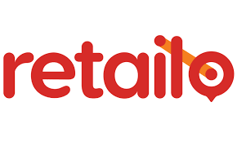
Identify core problems from a business. Share the questions your discussed with the business and the outcome you produced out of it.
Following Question were discussed in the meeting:
What predictive analytics are used by Retailo for its B2B selling?
In the future, what B2B problems does Retailo plan on solving? How do you guys price your product? how essential is dynamic pricing to Retailo ?
What is the conversion rate on Retailo's platform ?
How does Retailo currently use customer data to inform your marketing and sales strategies?
Has Retailo considered using machine learning to gain a deeper understanding of your customers and their behaviors, preferences, and needs? If so, what specific machine learning techniques have you explored?
It is often difficult to predict the demand for different products, which can result in stock outs or overstocking. How does Retailo manage its inventory?
what specific customer retention strategies or techniques is the company using to ensure that customers remain satisfied and loyal to the platform?
Your company give supplies on credit to even new retailers. How do you guys do credit ranking?
What Algorithms are you using for last mile delivery?

Slide 4
Core business points learnt from the selected articles (as provided on GCR)
B2B e-commerce platform for small and medium-sized grocery stores in the Middle East and North Africa (MENA) region.
aims to simplify the supply chain for small grocery stores by using technology to streamline the ordering process and reduce costs
Retailo use data analytics in number of ways to its advantages.
Inventory Management: Retailo uses data analytics to monitor inventory levels, track sales trends, and predict future demand. This helps the company to optimize its inventory levels, reduce waste, and ensure that it always has the right products in stock.
Customer Behavior: Retailo uses data analytics to analyze customer behavior, such as purchase history and browsing patterns. This helps the company to understand customer preferences and tailor its product offerings and marketing strategies accordingly.
Sales and Revenue: Retailo uses data analytics to track sales performance and revenue. This helps the company to identify areas of strength and weakness in its sales strategy and make data-driven decisions to improve performance.
Sales and Revenue: Retailo uses data analytics to track sales performance and revenue. This helps the company to identify areas of strength and weakness in its sales strategy and make data-driven decisions to improve performance.

Slide 5
Some possible KPIs that Retailo uses to evaluate seller ranking include:
Sales Revenue: This KPI measures the amount of money that Retailo is generating through its sales activities.
Average Order Value (AOV): This KPI measures the average amount of money that customers spend on each order.
Customer Acquisition Cost (CAC): This KPI measures the amount of money that Retailo is spending to acquire new customers.
Conversion Rate: This KPI measures the percentage of visitors to Retailo's website who make a purchase.
Customer Lifetime Value (CLV): This KPI measures the total amount of money that a customer is expected to spend on Retailo's products over their lifetime.

Slide 6
Customer Retention over Acquisition
Mr. Ibrahim told us briefly their methods for acquiring customers.
We also discussed some issues that Retailo faced during customer acquisition and measures that helped them in reducing those issues.
As of now, Retailo has stopped spending on Customer Acquisition and has pushed all of its focus over Customer Retention due certain reasons some of which are as follows: 1. Cost-Effective: 2. Referrals and Word-of-Mouth: 3. Better Customer Insights:
Notes:
1. Cost-Effective: Acquiring new customers became expensive due to the marketing and advertising costs associated with it. On the other hand, retaining existing customers became less expensive since the relationship is already established, and there is no need to spend money on advertising or marketing to attract them.
2. Referrals and Word-of-Mouth: Satisfied customers are more likely to refer their friends and family to Retailo, which can lead to new customer acquisition without additional marketing or advertising expenses. Word-of-mouth referrals can also help build a positive reputation for Retailo and increase customer loyalty.
3. Better Customer Insights: Retaining existing customers allows Retailo to gather more data and insights into their buying habits, preferences, and behaviors. This data can be used to improve the customer experience, optimize marketing strategies, and develop new products that meet customer needs.

Slide 7
Issues Regarding Analytics
He identified that they do not have proper effective dashboards.
Asked us to design a dashboard which can give the holistic view of all of company’s operation in one place

Slide 8
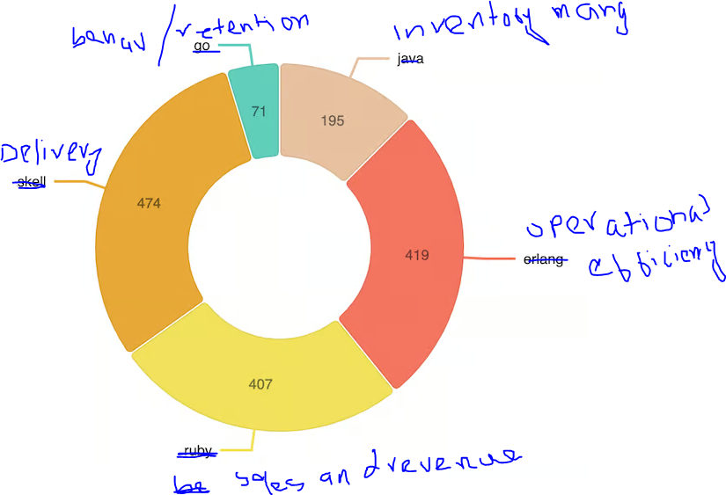
Possible Solutions
Our solution

Slide 9
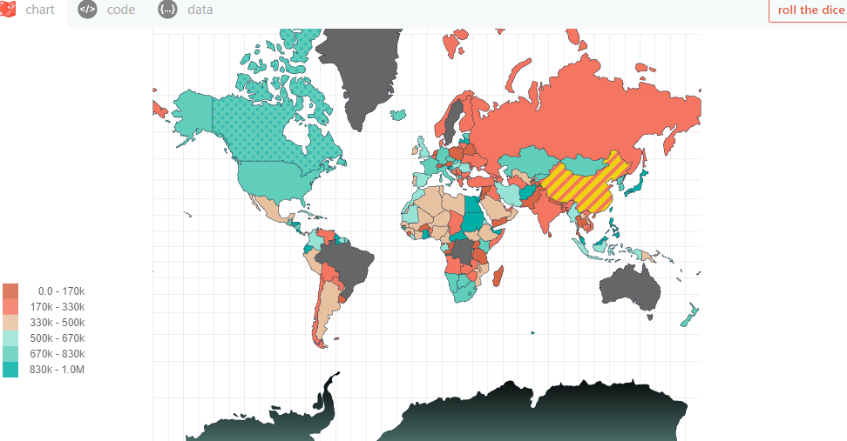
Possible Solutions
Another Solution:

Slide 10
Thank you

